Slide 1
Occupational Burnout
Peak Health Technologies and ISB AMPBA
13th May 2022

Slide 2
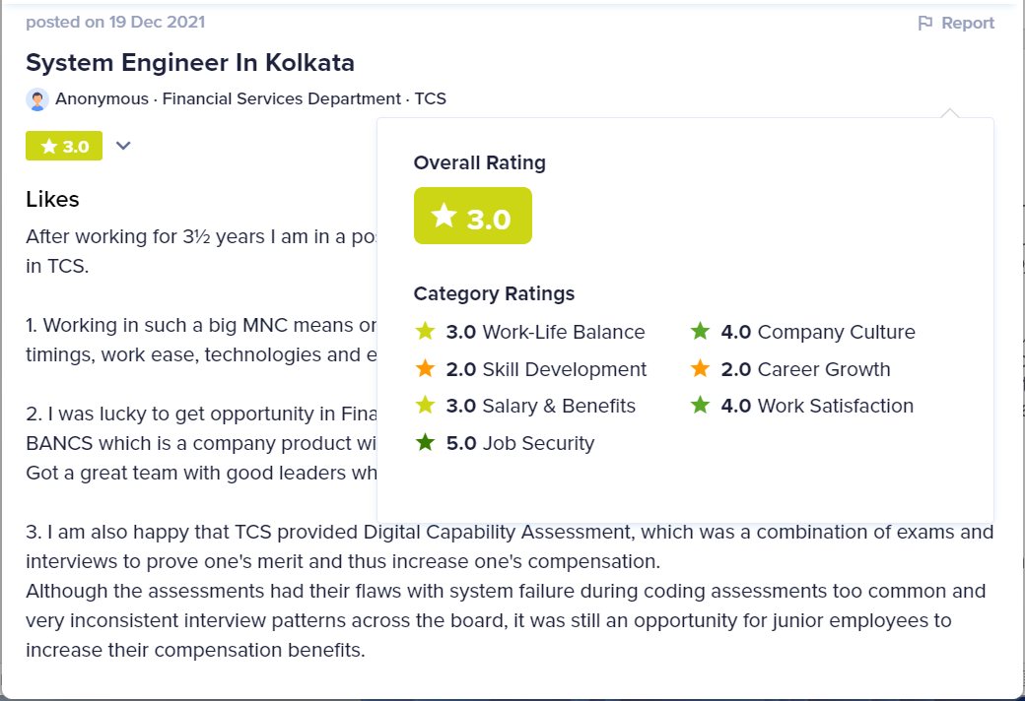
Data set
Underlying data will consist of facet scores with supporting text.
Peak Health data not yet available. Start with synthetic data set created from employee reviews. Replace synthetic data with Peak Health facet data, piece-meal, as it becomes available.
Create analytics and models on this synthetic data. There’s a rough mapping between our “facets” and the “categories” in the data set.
Data set consists of about 100,000 reviews from multiple companies (.csv files). Feel free to add on to this data set.
Each record has:
Company
Overall Score
Job Function
Location
Date
Review text
Likes (text)
Dislikes (text)
Ratings by category (each sub-score is a separate field): Work/life balance, Skill Development, Salary & Benefits, Job Security, Company Culture, Career Growth, Work Satisfaction

Slide 3
Project phases and deliverables
Phase 1: Reading, Data Exploration, Visualization
Background reading on Burnout, including: HBR guide to beating burnout
Deliverable: State of the Workforce dashboard
Phase 2: Facet text Summarization
eHR
Deliverable: Digital Watercooler (harness pros, likes, advice, similarities)
Deliverable: Digital Suggestion Box (harness cons, dislikes, complaints)
Phase 3 : Slice and Dice
Combine multiple reviews from employees in the same job function, from the same location, into a representative single employee
Deliverable: StrengthsFinder (compared to other similar employees)
Deliverable: State of the Workforce comparator (across job functions, locations, etc)
Phase 4: Model
Deliverable: Prediction model of sub-category scores based on job function, location, review text, features extracted in parts 1,2,3.
Phase 5: Publish
Jointly publish a research paper or a business article.

Slide 4
Project Summary
Data:
Synthetic data set of 100,000 records
Piece-meal replacement by Peak Health data
Deliverables:
State of the Workforce
eHR: Digital Watercooler
eHR: Digital Suggestion Box
Strengths Finder
Prediction model
Publication
Discussion:
Weekly zoom call between ISB team and Peak Health (TBD)
Milestones (from AMPBA Charter doc):
Project Charter Finalization: 20th May 2022
Weekly Reports: Every Sunday
Final Presentation to Sponsor: By 10th August 2022
Final Report Submission: 15th August 2022
Project Handover to the Sponsor: By 19th August 2022

